Slide 1

Economic Models in asia
The Rise and Stagnation of Japan: an Exception?

Slide 2
Japan Economic Miracle after the End of WWII
Japan was devasted at the end of the war: a cost estimated to $56 Billion and around 3 millions lives
Sustained economic growth from 1945 to 1991, particularly strong during the first 20 years (see real economic growth)
4 main factors explain this «miracle»:
Technological change
Accumulation of capital
Increased quantity and quality of labor
Increased international trade
A combination of strategic planning and firms’cooperation

Slide 3
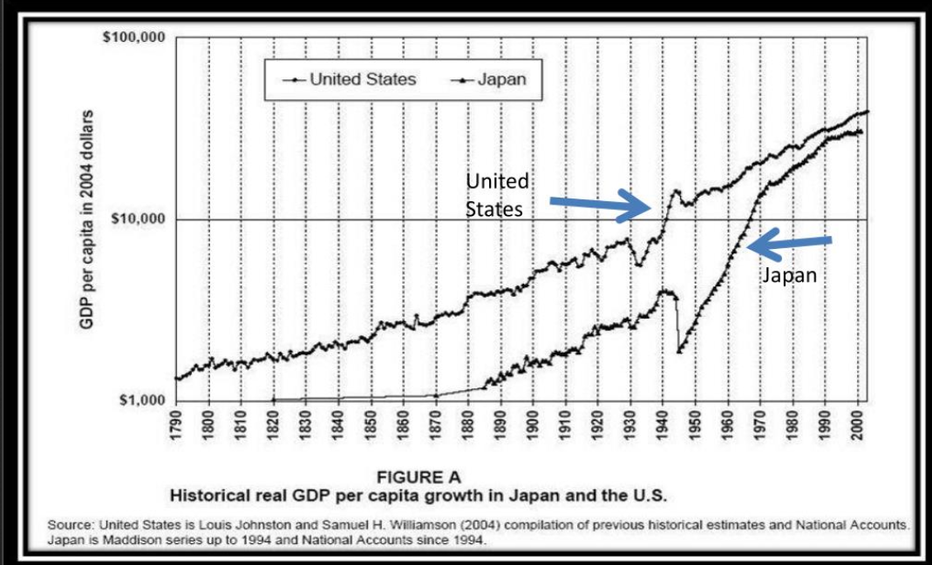
Historical Real GDP per Capita – Japan and USA

Slide 4
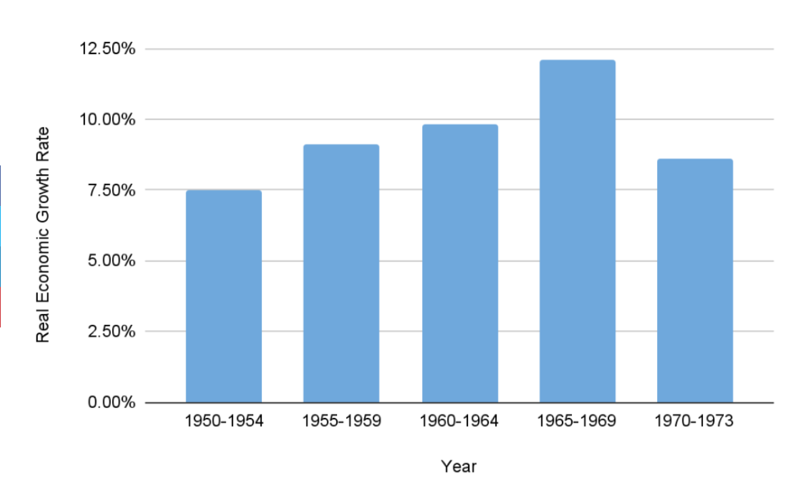
Japan Real Economic Growth 1950-1973

Slide 5
Technicological Change
After the War, Japan had lost ¼ of Industrial capacity + Depreciated stock
Condition for Japan to adopt an abundance of new technologies without having to wait for assets fully depreciated
Favorable to innovation
Fuel innovation
Accelerated by import of new technology in industries such as iron, steel, petrochimicals electronics, motor manufacturing and chemical engineering
Notes:
Understanding productivity will help us build a framework for understanding the factors that determine the level of income in a country and its growth rate over time.

Slide 6
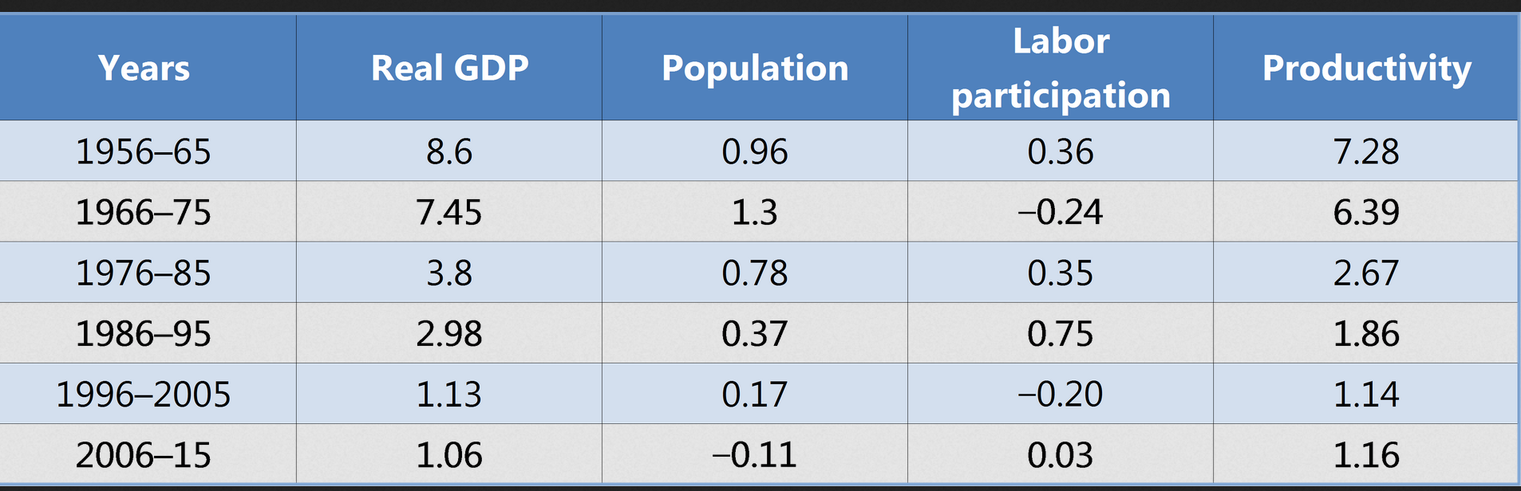
Japan’s Technological Change and Productivity

Slide 7
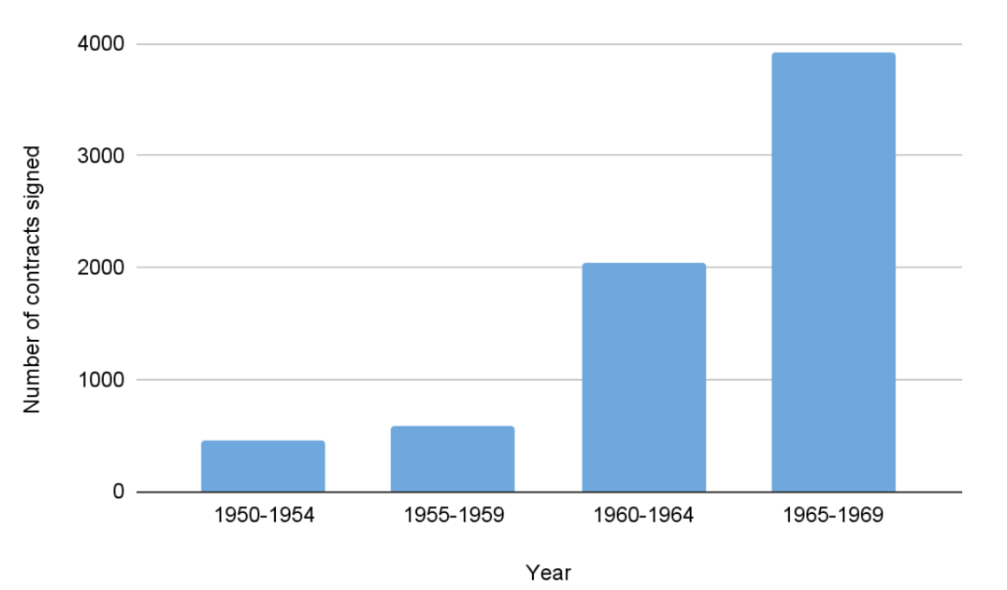
Number of contracts ( > 1 year) signed to import new technology in foreign currency between 1950 and 1969.

Slide 8
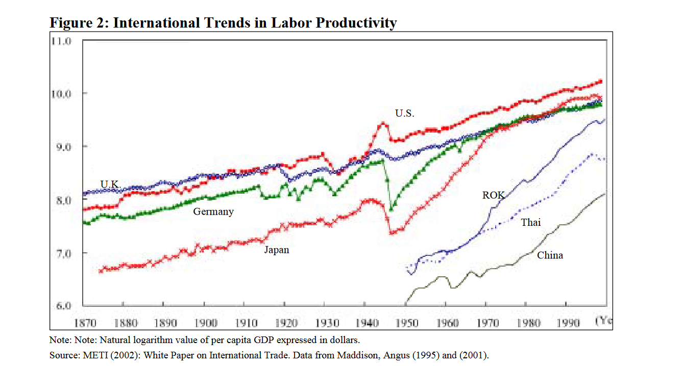
International Labor Productivity

Slide 9
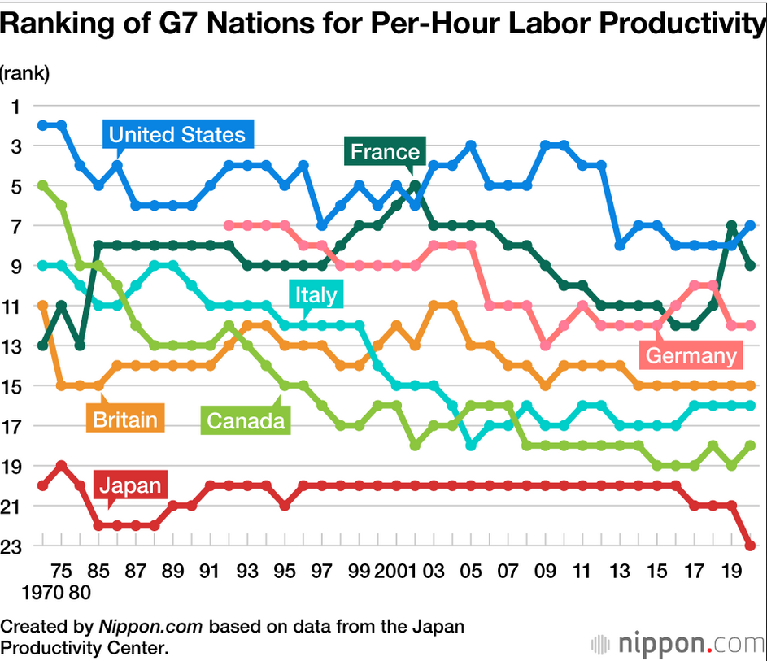
G7 Nations Per-Hour Labor Productivity

Slide 10
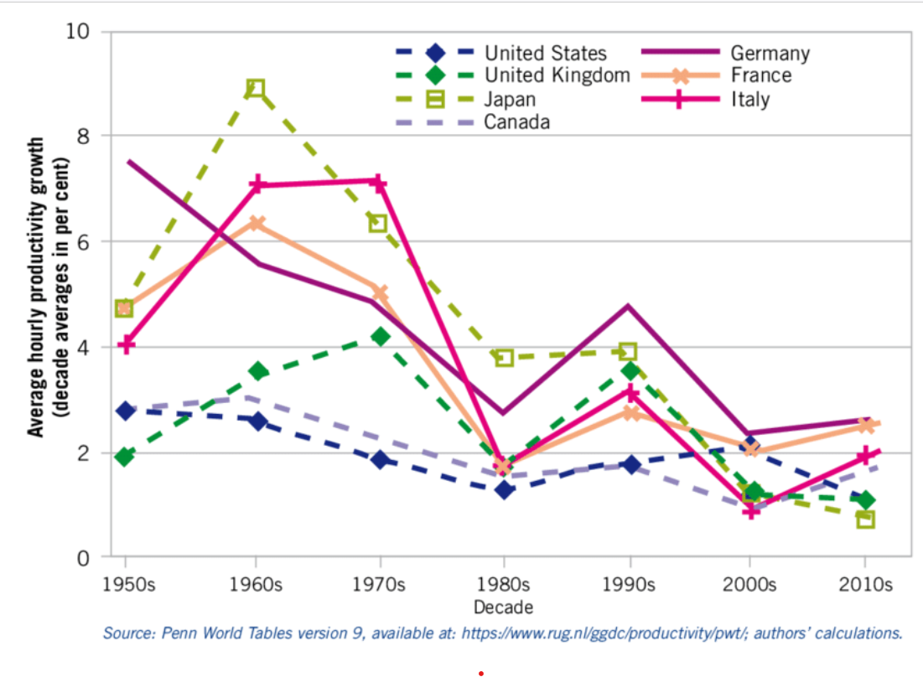
G-7 Average Hourly Productivity Growth

Slide 11
The Magic Touch of Loose Monetary Policy Combined with Loose Fiscal Policy
This technological race was fueled by cheap money
Central bank monetary policy essentially setting the interest rate low.
Firms were overborrowing and banks were overlending
Government use generous depreciation provisions and tax deductions:
Rapid growing corporations lower tax rate compare to slower-growing firms
Personal Income Tax: partial exemption of interest and dividend incomes from taxation.
Notes:
Physical capital:
Most production requires tools, and better tools allow workers to be more productive.
There is always new physical capital being added through investment and old capital being worn out and obsolete.
New - old physical capital = the net amount of physical capital that has been added to the economy.
Examples: Factories, machines, and cell phone towers.
Human capital:
New machines can usually boost productivity, but only if workers know how to use them.
Human capital contributes to growth because it helps workers in the economy produce more with the same amount of physical capital.
Education is one of the main ways that we think about building human capital.
Example: 100 years ago, the average person in the U.S. had 8 years of schooling, and today it is closer to 12.
Technology:
Doesn’t necessarily mean a “new gadget” like the word is usually used. Instead, it defines changes in productivity through big or small innovations that produce more output with the same amount of physical and human capital.
Examples: Agricultural breakthroughs (higher-yielding seed varieties), invention of the internet, more efficient water pumps, and car engines with a higher MPG.
Natural resources: There are two categories:
Renewable: Can be replenished over time (e.g., trees, rivers, electricity).
Nonrenewable: Can not be replenished over time (e.g., coal, oil, gold).

Slide 12
Transfers of Technology
By importing technology, it fosters innovation:
In 1963 the japan Information center for Science and Technology wrote 210 000 abstracts of foreign scientific papers
New technologies imported were improved:
Machine tools and robot were imported and used in the automobile industry
Imported generators adapted to improve efficiency of electric utility industry
Technology = 20% more efficient
9500 large firms = spending 1/3 of their R&D expenditure and improving imported technique
Notes:
Sometimes, the growth accounting equation will break capital down into separate variables for both human and physical capital.

Slide 13
Capital Accumulation
Concentration of capital in rapid growing industries:
In contrast with otehr countries investing in housing or social overhead capital
Strong commitment to close the technological gap in order to increase international competitiveness
High return on investment because of the high marginal productivity
High rate of savings have avoided high inflation:
1950-1970: personal savings rate = 18,5% Japan 7% US
Notes:
In 1961, India was at risk of famine. The population was booming, and no more farmland was available. By 1985 the specter of famine had all but disappeared, not only in India but across Asia. In just 25 years, crop yields had doubled, easily outpacing the growth of the population.
Rockefeller Foundation funded researchers, such as the International Rice Research Institute in the Philippines, to develop new crop varieties. One new crop was “miracle rice.”. “Miracle rice” required more intensive fertilizer and irrigation treatments than traditional varieties but produced about double the amount of rice per plant.
Many economists believe that the Green Revolution partly explains why Asia’s economies have grown quickly in the last half century: When you don’t need as many workers to grow food, they can do something else instead, such as work in factories in the city.

Slide 14
Quantity and Quality of Labor
NBER paper finds that the increase in quantity and quality of labor = 30% of the Japanese economic growth
After the war, large increase in labor so wages increased less rapidly than productivity in the 1950’s
In the 1960’s, wage increase in line with productivity
Labor moved from low productivity sector like agriculture to high productivity (automobile, electronics, aviation…)
Notes:
Convergence theory relates to the idea of decreasing marginal returns to the factors of production. Countries with little initial physical and human capital will get a higher return from adding a unit of capital than countries that start with a higher level. Note for students that although they will eventually converge to the same growth rate, that does not mean that they will converge to the same level of income. The map here illustrates how many of the richer countries have been growing slowly over the past 20 years and that the fastest growth is in some of the poorest countries. Make it clear that this theory does not always hold, as many African countries have had similar or lower levels of physical and human capital than East Asia but have not experienced high growth rates.

Slide 15
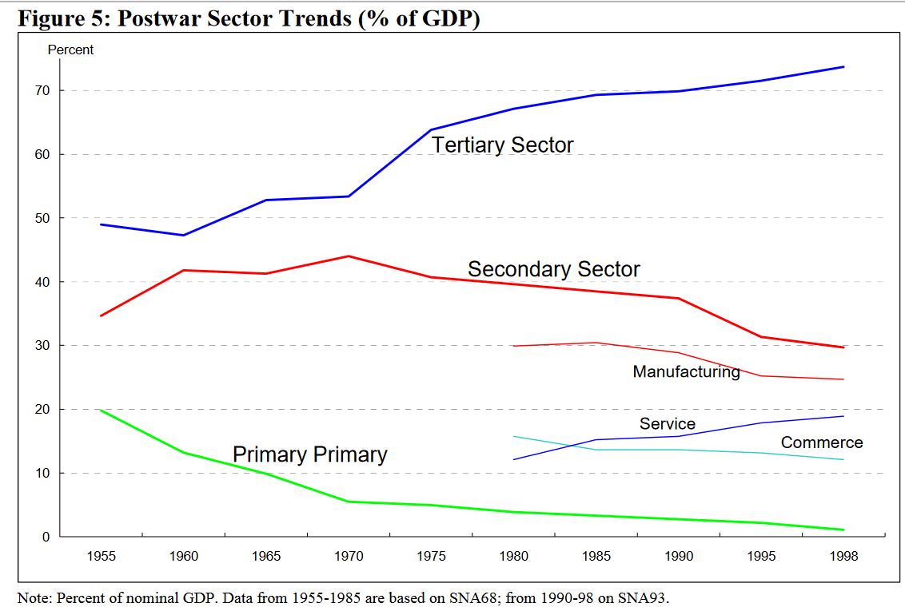
Postwar Sector Trends
Access the text alternative for slide images.
Notes:
Overall, higher incomes within a country correlate with a higher life expectancy. However, at lower levels of income, the relationship is not as clear. Some countries have increased incomes without making much progress in life expectancy and vice versa.

Slide 16
The Role of Kereitsu
Kereitsu = large business groups linking banks, trading companies industrialist through ownership or stock / long standing exclusive relationship
Size gives financial strength and connections
Kereitsu outperform national and international competitors in high growth sector
Government protects Kereitsu
Ministry of industrial trade and Industry allowing administrative cartels + collusive activities:
Mergers amongst 5 largest firms in a given industry
Japanese business environment very competitive
Notes:
Countries employ savings, investment, education, health, technological development, and governance policies to try to help stimulate growth.
There is no one-size-fits all policy.

Slide 17
The Role of Kereitsu
To keep up with product design and implement new production techniques, employees work long hours and are loyal to the firm
High standards with strict rules
Management practices innovation:
Total quality control
Lean production
Cross-functional product teams
Just in time
Notes:
When average GDP increases, the average level of education and health increase too. But this is not a guarantee. For example, the rate of child malnutrition in India didn’t change between 1998 and 2005 even though India experienced strong economic growth. Examples of policy mechanisms include property rights, rule of law, and efficiency/effectiveness of the legal system (e.g., courts). Economic development can lead to economic growth if there are fundamentals like property rights, the rule of law, and human capital.

Slide 18
International Trade
Exports increase rapidly after the war:
Tax deductions for overseas sales expenditures + preferential loans = competitive exports
Mergers + Anti-competitive behavior encouraged in export sectors
Key factor to stay ahead of international competitor = ability to change exports
1950-1965 = textile and sundry goods to machinery and then to metals
Thanks to increased efficiency + corporations’ ability = ability to stay competitive
Ability to produce goods most demanded

Slide 19
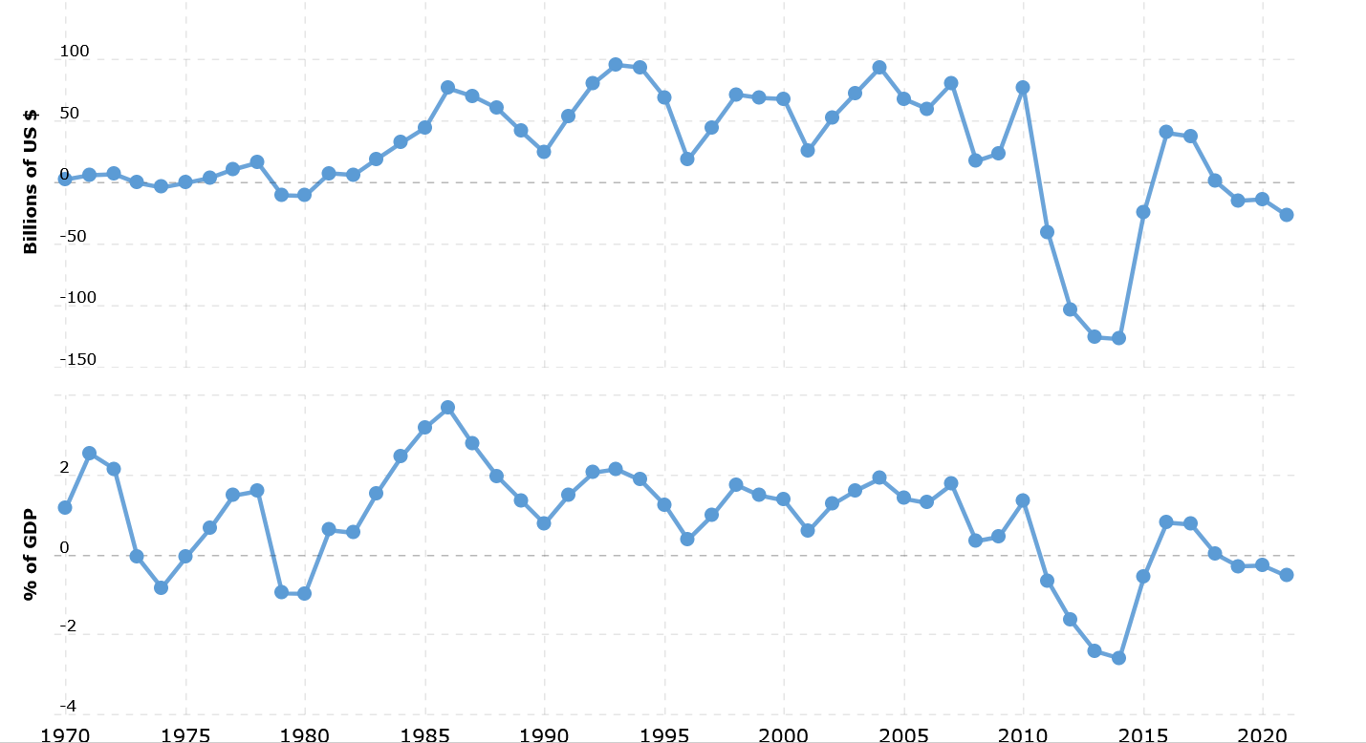
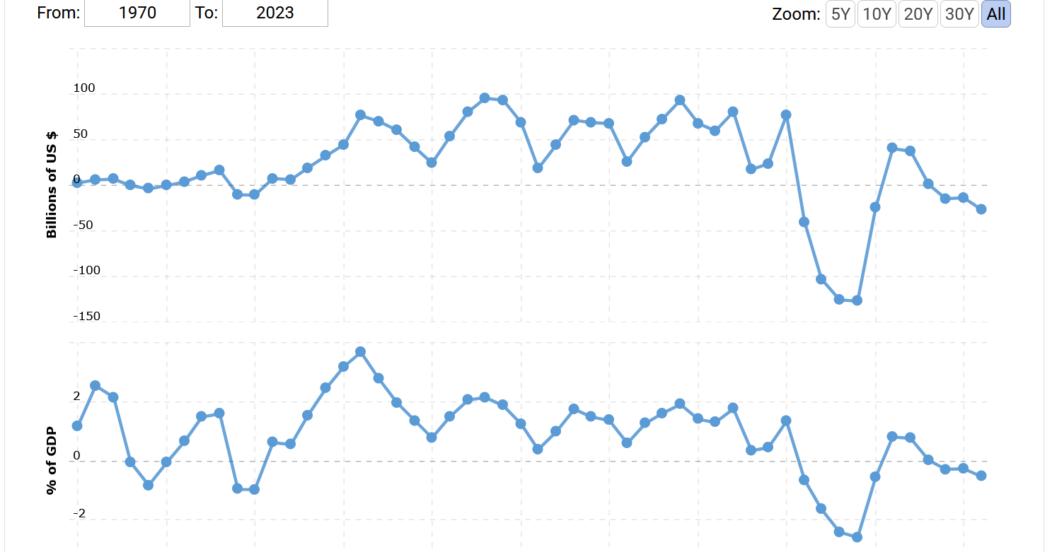
Japan Trade Balance 1970-2024

Slide 20
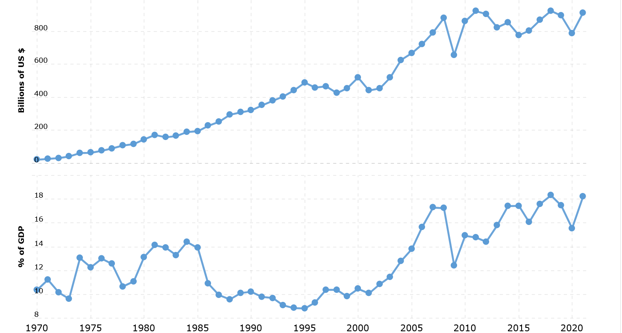
Japan Exports 1970-2024

Slide 21
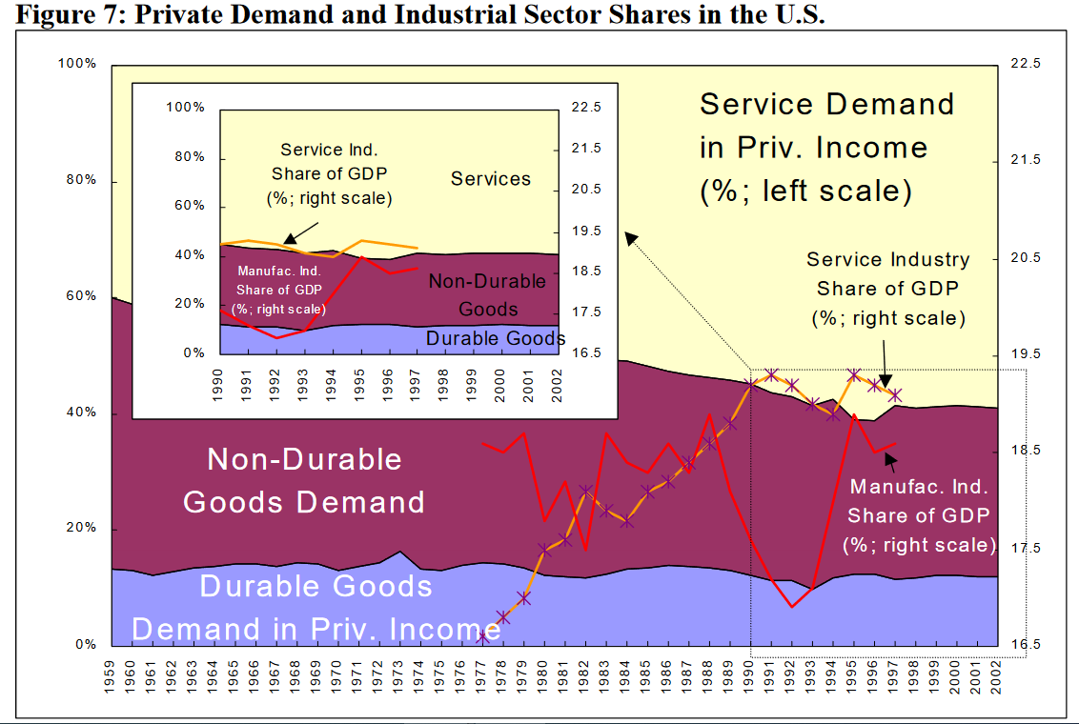
Private Demand and Industrial Sector Shares in the US

